Slide 1
Weathermate- A real time weather app
CAPSTONE PROJECT
Presented By:
PRIYA KINDRA
Galgotias College Of Engineering And Technology
Computer Science And Engineering (AI)

Slide 2
outline
Problem Statement
System Development Approach (Technology Used)
Algorithm & Deployment (Step by Step Procedure)
Result
Conclusion
References

Slide 3
Problem Statement
Weather conditions are highly unpredictable and change rapidly, making it difficult for people to plan daily activities.
There is often a delay or inconsistency in weather updates available across different platforms.
Air Quality information is either missing or too complex for normal users to understand.
Existing systems usually provide limited details, focusing only on temperature, while other important parameters like wind speed, humidity, or forecast are ignored.
Many weather applications are not lightweight or user-friendly, which reduces accessibility for common users.

Slide 4
Why is thIs particular topic chosen?
Weather affects every aspect of human life—from travel and health to agriculture and daily routines. Yet, people often face confusion due to scattered or delayed weather updates. With the rise of environmental concerns and pollution, understanding parameters like air quality, humidity, and wind speed has become more crucial than ever.
This project was chosen to bridge the gap between complex weather data and user-friendly access. By building a lightweight, interactive, and accessible application, the aim is to help individuals make smarter, well-informed decisions in their everyday lives.

Slide 5
abstract
This project presents a web-based Weather Application developed using HTML, CSS, and JavaScript. It integrates the OpenWeatherMap API to fetch and display real-time weather data for any location. The application offers a clean and responsive user interface, enabling users to quickly check current weather conditions. This project demonstrates practical web development skills, effective API integration, and the ability to transform coding concepts into a functional, real-world application.

Slide 6
objective
The primary objective of this project is to design and develop a Weather Forecasting Web Application that provides accurate, real-time weather insights in a simple and interactive way.
Specific Objectives:
To display real-time weather conditions such as temperature, humidity, wind speed, and pressure.
To integrate Air Quality Index (AQI) for monitoring pollution levels.
To provide hourly and 5-day forecast for better planning.
To design a lightweight and user-friendly interface using HTML, CSS, and JavaScript.
To utilize OpenWeatherMap API for fetching reliable global weather data.

Slide 7
Key features
Current Weather & Location
Shows temperature, weather condition, date, and location.
Search by city name or use current location (Geolocation API).
5-Day Forecast
Displays upcoming 5 days’ temperature & conditions.
Uses icons for weather representation (cloudy, sunny, rainy, etc.).
Hourly Forecast
Shows weather conditions hour by hour (like 9 AM, 12 PM, etc.).
Includes temperature and weather icon.
Air Quality Index (AQI)
Displays overall AQI status (Good, Moderate, Poor).
Shows pollutants: CO, O3, PM2.5, PM10, NO, NO2, SO2, NH3.
Sunrise & Sunset Times
Shows sunrise and sunset times for the selected city using data from the OpenWeatherMap API.
Converts UNIX timestamp to local time
Extra Weather Details
Humidity (%).
Pressure (hPa).
Visibility (km).
Wind speed (m/s).
Feels like temperature.

Slide 8
System Approach
🔹 System Development Approach (Technology Used)
Frontend Development :
HTML5 – Built the structural foundation of the application by defining clear sections such as current weather, today’s highlights, and 5-day forecast. Semantic tags (<header>, <section>, <article>) improved readability, accessibility, and maintainability of the project.
CSS3 – Designed a dark-themed, responsive dashboard that adapts smoothly across desktop, tablet, and mobile devices. Used Flexbox and Grid for precise alignment of forecast cards and highlights. Added styling enhancements like hover effects, smooth transitions, and visual hierarchy so that important data (temperature, AQI, humidity) is highlighted prominently.
JavaScript (ES6) – Managed the core functionality and interactivity of the project. Implemented API calls, processed responses, and dynamically updated UI elements through DOM manipulation. Used modern ES6 features (arrow functions, template literals, let/const) for clean, modular code. Applied async/await for real-time weather data fetching without UI lag, ensuring a smooth user experience.

Slide 9
System Approach
🔹 System Development Approach (Technology Used)
API Integration :
Integrated OpenWeatherMap API to fetch real-time weather data.
Multiple endpoints were utilized:
Current Weather → Temperature, Humidity, Wind Speed, Pressure
5-Day Forecast → 3-hour interval data grouped into daily summaries
Air Quality Index (AQI) → Overall index + pollutant details (PM2.5, PM10, CO, NO2, O3, SO2, NH3)
Sunrise & Sunset Timings → Fetched in UNIX format and converted into readable local time
This integration ensures the dashboard always displays live, accurate, and location-specific updates.

Slide 10
System Approach
🔹 System Development Approach (Technology Used)
Data Handling :
API returns data in JSON format (nested objects & arrays).
Performed JSON parsing to extract key parameters:
Temperature, Humidity, Pressure
Wind Speed & Direction
Sunrise/Sunset timestamps
Forecast list & pollutant components
Used DOM Manipulation to dynamically inject values into UI elements (without page reload).
Converted raw API values into user-friendly formats:
Kelvin → Celsius
UNIX timestamp → Local readable time (e.g., 06:15 AM)
Grouped 3-hourly forecast entries into daily cards for a cleaner and professional dashboard view..

Slide 11
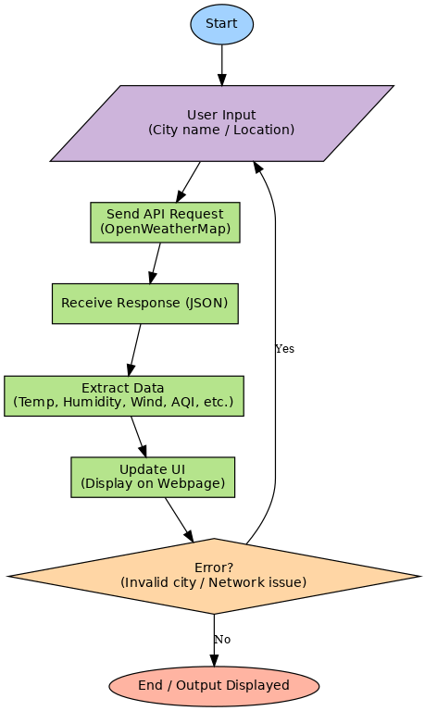
flowchart

Slide 12
Algorithm
1
Start Application – Launch the weather app in browser
Get Input - User location (via geolocation) or enter city name manually
3
END – Successfully present complete weather information to the user
4
6
7
Send API Request - OpenWeatherMap (Current Weather, Forecast,AQI) using javascript
5
Extract Data – Temperature ,Humidity, Pressure, Wind, Sunrise/Sunset, AQI
Update UI – Display details dynamically using HTML, CSS and Javascript
8
Handle Errors – Shows messages for invalid city names, wrong input or network issues
Receive Response – API returns data in JSON format containing weather details
2

Slide 13
DEPLOYMENT
1
Developed Frontend – HTML, CSS, Javascript
Integrated API – OpenWeatherMap API
3
4
6
Tested Locally – Verify in Browser
5
Deployed on Vercel – Connected Github – Auto Deploy enabled
Live Project Link – Accessible from anywhere
Pushed Code – Uploaded project to GitHub Repository
2

Slide 14
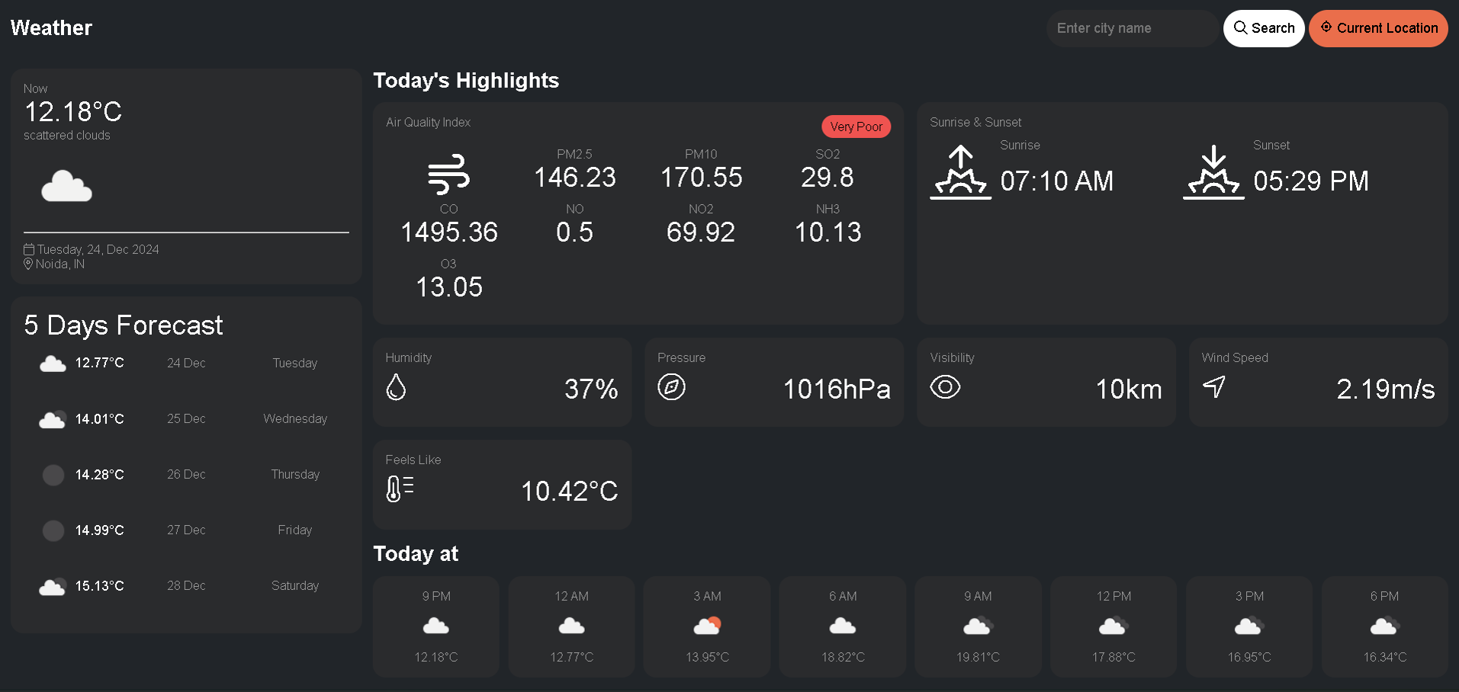
Result

Slide 15
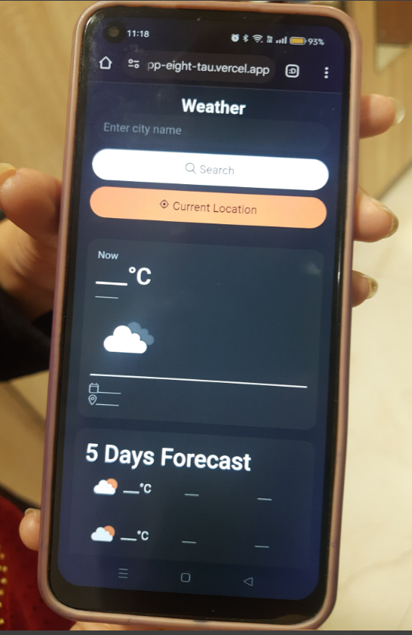
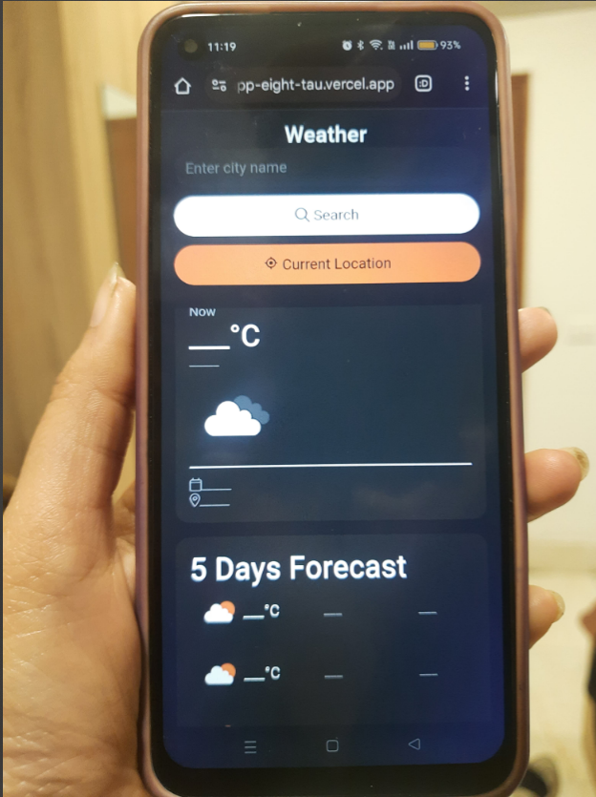
Result
Github link
https://github.com/priya6395-dev/Weather-web-app
Deployed Live Project Link: https://weather-web-app-eight-tau.vercel.app/

Slide 16
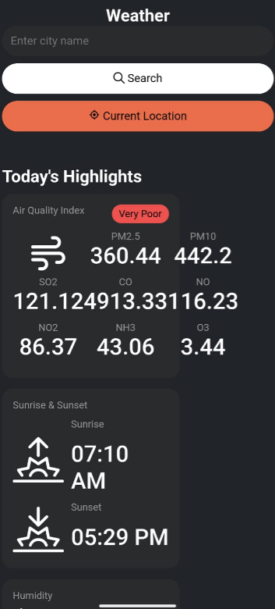
Result
Github link
https://github.com/priya6395-dev/Weather-web-app
Deployed Live Project Link: https://weather-web-app-eight-tau.vercel.app/

Slide 17
Result
Developed a dynamic Weather Web Application with real-time data integration
Displays comprehensive weather details: Temperature, Humidity, Pressure, Wind Speed
Shows Sunrise & Sunset timings, Air Quality Index (AQI), Hourly & 5-Day Forecast
Deployed on Vercel with code maintained on GitHub
Provides a responsive, user-friendly & visually interactive interface
Live project accessible anytime, anywhere via project link

Slide 18
WHAT I HAVE LEARNT
UI/UX Skills – Responsive UI/UX with HTML&CSS
API Integration – Fetch & JSON parsing
Practical Web Development – Linking Frontend with API
Real-world application building
JavaScript Concepts – Async, promises, error handling

Slide 19
Conclusion
I successfully developed a Weather Application using HTML, CSS and JavaScript.
By integrating the OpenWeatherMap API, the app is able to fetch and display real-time weather information.
This project not only improved my frontend development skills, but also gave me practical exposure to API usage in web development.
Overall, it was a great learning experience that strengthened my technical knowledge and problem-solving approach.

Slide 20
References
OpenWeatherMap API – https://openweathermap.org/api
MDN Web Docs (JavaScript, HTML, CSS) – https://developer.mozilla.org
W3Schools (Frontend Tutorials) – https://www.w3schools.com
Stack Overflow – For troubleshooting and debugging support
Guidance/Code Reference - NanthiniMoha/TNSDC-FWD-DIGITAL_PORTFOLIO

Slide 21
THANK YOU

